Slide 1
Exploring the Relationship between Design Metrics and Software Diagnostics using Machine Learning
Pooja Krishnan
pooja.Krishnan@tum.de

Slide 2
Contents
Objective
Data Collection
Static
Dynamic
Test
Bug
Machine Learning
Initial Assumption
Selecting Attributes
Use Cases
Visualizing Results
My Experience- What’s good and bad???
References

Slide 3

Objective

Slide 4
Data Collection: Static
Attributes :
Cyclomatic Complexity
Weighted Methods per Class (WMC)
Decision Depth
Depth of inheritance tree (DIT)
Class Cohesion: LCOM Metrics
Knots
Maintainability Index (MI) (including comments)
Average no of statements
Fan in
Fan out
Notes:
To do: add animations for changes and talk about problems of retrieving the data in correct format like csv and open source tool.
It is a quantitative measure of the number of linearly independent paths through a program's source code --McCabe

Slide 5
Data Collection: Static
Attributes :
Cyclomatic Complexity Maximum, Average Complexity
Weighted Methods per Class (WMC)
Decision Depth Maximum, Average depth
Depth of inheritance tree (DIT)
Class Cohesion: LCOM Metrics
Knots – Percentages of Branches
Maintainability Index (MI) (including comments)
Average no of statements
Tool : CodePro and SourceMonitor
Notes:
To do: add animations for changes and talk about problems of retrieving the data in correct format like csv and open source tool

Slide 6
Data Collection: Dynamic
Dynamic coupling metrics
Dynamic cohesion metrics
Degree Centrality

Slide 7
Data Collection: Dynamic
Dynamic coupling metrics Coupling between Objects
Dynamic cohesion metrics Information Flow Complexity
Degree Centrality
Tools: Python Script to parse the graphs, compute in degree and out degree

Slide 8
Data Collection: Test Characteristics
No of Passed test cases
No of Failed test cases
Total no of Test cases
No of statements executed
Defect Density

Slide 9
Data Collection: Test Characteristics
No of Passed test cases
No of Failed test cases
Total no of Test cases
No of statements executed
Defect Density Density, Diversity and Uniqueness(DDU)
Tool : Python script

Slide 10
Data Collection : Bug Characteristics
Attributes
Bug Severity – Blocker , Major, Minor…….
Unused Duplicate statements
Bug Type
Bug Location

Slide 11
Data Collection : Bug Characteristics
Attributes
Bug Severity – Blocker , Major, Minor…….
Unused Duplicate statements
Bug Type
Bug Location
No of Modified
No of Chunks
No of Failing tests
No of Repair Actions
Exception Type
From https://dl.acm.org/citation.cfm?id=3097446

Slide 12
Learning
Dstar:(Ncf**2)/(Nuf+Ncs)
Initial Assumptions:
Model: Support Vector Machine
Attributes: All attributes
Labels: Three labels – Good , Bad, Unknown
Train/test Split: 80-20 Split
Result
Correctly Classified Instances 84.4512 %
Incorrectly Classified Instances 15.5488 %
Confusion Matrix
bad | good | unknown | <--Classified as
277 | 0 | 0 | bad
37 | 0 | 0 | good
14 | 0 | 0 | unknown
Notes:
To do: Tell about the papers you referred talked about SVM and Random Forests
Ncf = 0 #Number of failed test cases that cover the statement
Nuf = 0 # Number of failed test cases that do not cover the statement
Ncs = 0 #Number of successful test cases that cover the statement

Slide 13
Selecting Attributes – Correlation Matrix
1 | 0.37 | 0.31 | 0.11 | 0.01 | 0.11 | -0.06 | -0.05 | -0.15 | -0.03 | 0.24 | 0.05 | 0.09 | 0.01 | -0.06 | 0.06 | 0.02 | Lines
0.37 | 1 | 0.32 | 0.35 | -0.01 | 0.35 | 0.05 | -0.02 | 0.07 | -0.16 | -0.12 | -0.03 | -0.05 | -0.01 | -0.08 | -0.04 | -0.06 | Max Complexity
0.31 | 0.32 | 1 | 0.16 | -0.01 | 0.16 | 0.14 | -0.08 | 0 | 0.01 | -0.1 | -0.09 | 0.03 | -0.01 | 0 | 0.03 | -0.03 | Max Depth
0.11 | 0.35 | 0.16 | 1 | 0.05 | 1 | 0.14 | -0.04 | 0.11 | -0.18 | 0.04 | 0.08 | -0.01 | 0.05 | 0.01 | 0 | -0.04 | num_of_tests
0.01 | -0.01 | -0.01 | 0.05 | 1 | 0.04 | 0.08 | -0.02 | -0.03 | 0.03 | 0.01 | -0.01 | 0.19 | 1 | 0.15 | 0.1 | -0.05 | num_of_passed_tests
0.11 | 0.35 | 0.16 | 1 | 0.04 | 1 | 0.14 | -0.04 | 0.11 | -0.18 | 0.04 | 0.08 | -0.01 | 0.04 | 0.01 | 0 | -0.04 | num_of_failed_tests
-0.06 | 0.05 | 0.14 | 0.14 | 0.08 | 0.14 | 1 | 0 | 0.05 | 0.02 | -0.23 | -0.08 | -0.08 | 0.07 | 0 | 0.01 | -0.19 | CBO
-0.05 | -0.02 | -0.08 | -0.04 | -0.02 | -0.04 | 0 | 1 | 0.1 | -0.01 | -0.04 | 0.01 | 0.03 | -0.02 | -0.02 | -0.03 | -0.03 | IFC(Information Flow complexity)
-0.15 | 0.07 | 0 | 0.11 | -0.03 | 0.11 | 0.05 | 0.1 | 1 | -0.03 | -0.09 | 0.7 | -0.16 | -0.02 | -0.09 | -0.12 | 0.06 | Density
-0.03 | -0.16 | 0.01 | -0.18 | 0.03 | -0.18 | 0.02 | -0.01 | -0.03 | 1 | 0.22 | 0.16 | 0.07 | 0.04 | 0.06 | 0.05 | -0.05 | Diversity
0.24 | -0.12 | -0.1 | 0.04 | 0.01 | 0.04 | -0.23 | -0.04 | -0.09 | 0.22 | 1 | 0.53 | 0.06 | 0.01 | 0.02 | 0.02 | 0.14 | Uniqueness
0.05 | -0.03 | -0.09 | 0.08 | -0.01 | 0.08 | -0.08 | 0.01 | 0.7 | 0.16 | 0.53 | 1 | -0.1 | -0.01 | -0.07 | -0.1 | 0.2 | DDU
0.09 | -0.05 | 0.03 | -0.01 | 0.19 | -0.01 | -0.08 | 0.03 | -0.16 | 0.07 | 0.06 | -0.1 | 1 | 0.19 | 0.58 | 0.59 | -0.03 | No of Modified
0.01 | -0.01 | -0.01 | 0.05 | 1 | 0.04 | 0.07 | -0.02 | -0.02 | 0.04 | 0.01 | -0.01 | 0.19 | 1 | 0.15 | 0.1 | -0.06 | No of Chunks
-0.06 | -0.08 | 0 | 0.01 | 0.15 | 0.01 | 0 | -0.02 | -0.09 | 0.06 | 0.02 | -0.07 | 0.58 | 0.15 | 1 | 0.65 | -0.02 | No of Failing tests
0.06 | -0.04 | 0.03 | 0 | 0.1 | 0 | 0.01 | -0.03 | -0.12 | 0.05 | 0.02 | -0.1 | 0.59 | 0.1 | 0.65 | 1 | -0.03 | No of Repair Actions
0.02 | -0.06 | -0.03 | -0.04 | -0.05 | -0.04 | -0.19 | -0.03 | 0.06 | -0.05 | 0.14 | 0.2 | -0.03 | -0.06 | -0.02 | -0.03 | 1 | Exception Type

Slide 14
Use Case 1:
Model: Random Forests
Attributes: Based on correlation matrix
Labels: Three labels – Good , Bad, Unknown
5 fold cross validation
Result
Correctly Classified 86.0182% Incorrectly Classified 13.9818 %
Use Case 2:
Model: Random Forests
Attributes: PCA
Labels: Two labels – Good , Bad
10 fold cross validation
Bagging, batch size:50
Num of Iterations:500
Result
Correctly Classified 89.6657 % Incorrectly Classified 9.7983 %
bad | good | Unknown | <--Classified as
273 | 4 | 1 | bad
27 | 10 | 0 | good
13 | 1 | 0 | unknown
bad | good | <--Classified as
287 | 5 | bad
29 | 8 | good
Notes:
Check whether Preprocessing of PCA needs to be added. Data is already available in file ‘R3_Rm_UnK_withPCA_Kvalues’ but then be prepared to explain about why preprocessing did not help much.. Or atleast whats your take on it.

Slide 15
Use Case 3:
Attributes: Static features
K fold: 10
Result
Correctly Classified 84.1945 %
Incorrectly Classified 15.8055 %
Use Case 4:
Attributes: Dynamic features
Result
Correctly Classified 85.6506 % Incorrectly Classified 14.3494 %
Use Case 5:
Attributes: Test Characteristics
Result
Correctly Classified 89.3614 % Incorrectly Classified 10.6386 %
Use Case 6:
Attributes: Bug Characteristics
Result
Correctly Classified 90.9639 % Incorrectly Classified 9.0361 %
Notes:
Check whether Preprocessing of PCA needs to be added. Data is already available in file ‘R3_Rm_UnK_withPCA_Kvalues’ but then be prepared to explain about why preprocessing did not help much.. Or atleast whats your take on it.

Slide 16
Best Model
Model: Random Forests
Attributes: Based on correlation matrix
Labels: Three labels – Good , Bad
7 fold cross validation
Result
Correctly Classified 90.2736%
Incorrectly Classified 8.7349 %
bad | good | <--Classified as
287 | 5 | bad
27 | 10 | good

Slide 17
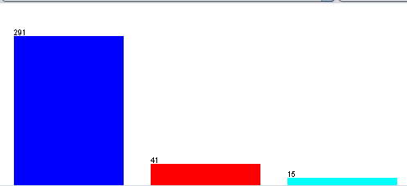
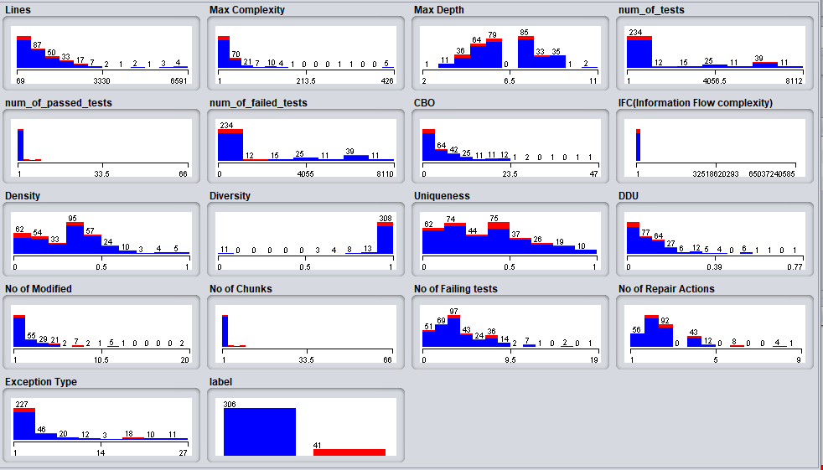
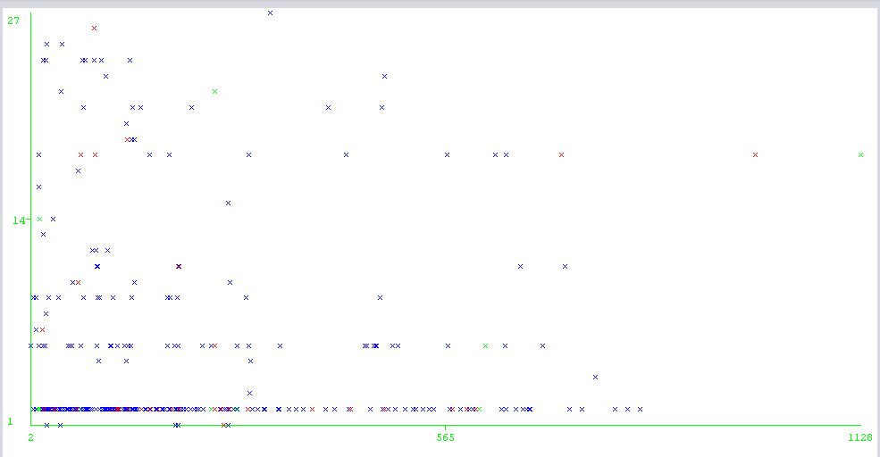
Some Visualizations
Distribution of class labels

Slide 18
To Summarize My Experience
Importance of good metrics
Regression or classification???
Results with different Machine Learning Models
Using Preprocess technique to select attributes
Train-Test Split to K-fold
Role of visualization

Slide 19
References
Software Fault Localization, W. Eric Wong, and Vidroha Debroy Department of Computer Science University of Texas at Dallas
A Pluggable Tool for Measuring Software Metrics from Source Code. Yoshiki Higo, Akira Saitoh, Goro Yamada, Tatsuya Miyake, Shinji Kusumoto, Katsuro Inoue Graduate School of Information Science and Technology, Osaka University, 1-5, Yamadaoka, Suita, Osaka, 565-0871, Japan
Deriving Coupling Metrics from Call Graphs Simon Allier, Stephane Vaucher, Bruno Dufour, and Houari Sahraoui VALORIA, Universit´e de Bretagne-Sud DIRO, Universit´e de Montr´eal
Dynamic Metrics for Object Oriented Designs1 Sherif M. Yacoub, Hany H. Ammar, and Tom Robinson, Department of Computer Science and Electrical Engineering, West Virginia University Morgantown, WV26506
A Test-suite Diagnosability Metric for Spectrum-based Fault Localization Approaches Alexandre Perez∗†, Rui Abreu∗†, Arie van Deurse University of Porto & HASLab, INESC TEC, Portugal †Palo Alto Research Center, USA, Delft University of Technology, The Netherlands alexandre.perez@fe.up.pt, rui@computer.org, arie.vandeursen@tudelft.nl
Exploring Machine Learning Techniques for Fault Localization Luciano C. Ascari Lucilia Y. Araki Aurora R.T. Pozo Silvia R. Vergilio Federal University of Parana (UFPR), Computer Science Department, CP: 19081, CEP 19031-970 Centro Politecnico, Jardim das Americas, Curitiba- Brazil

